Slide 1
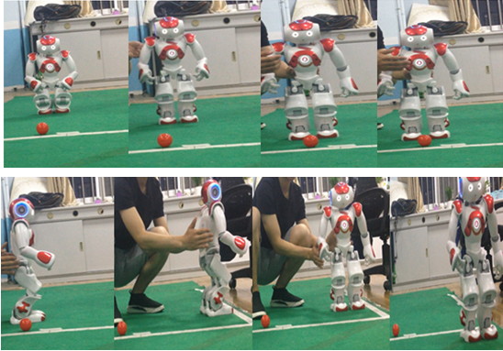
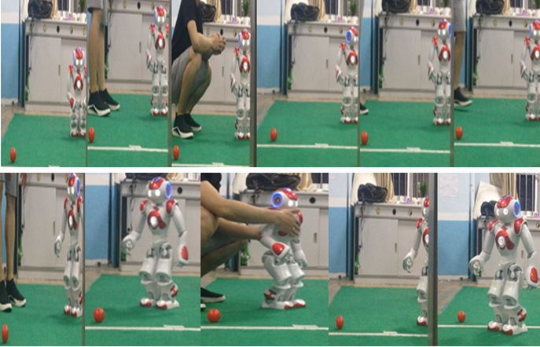
Motion Control and Computer Vision Application in Autonomous, Programmable Robots

Slide 2
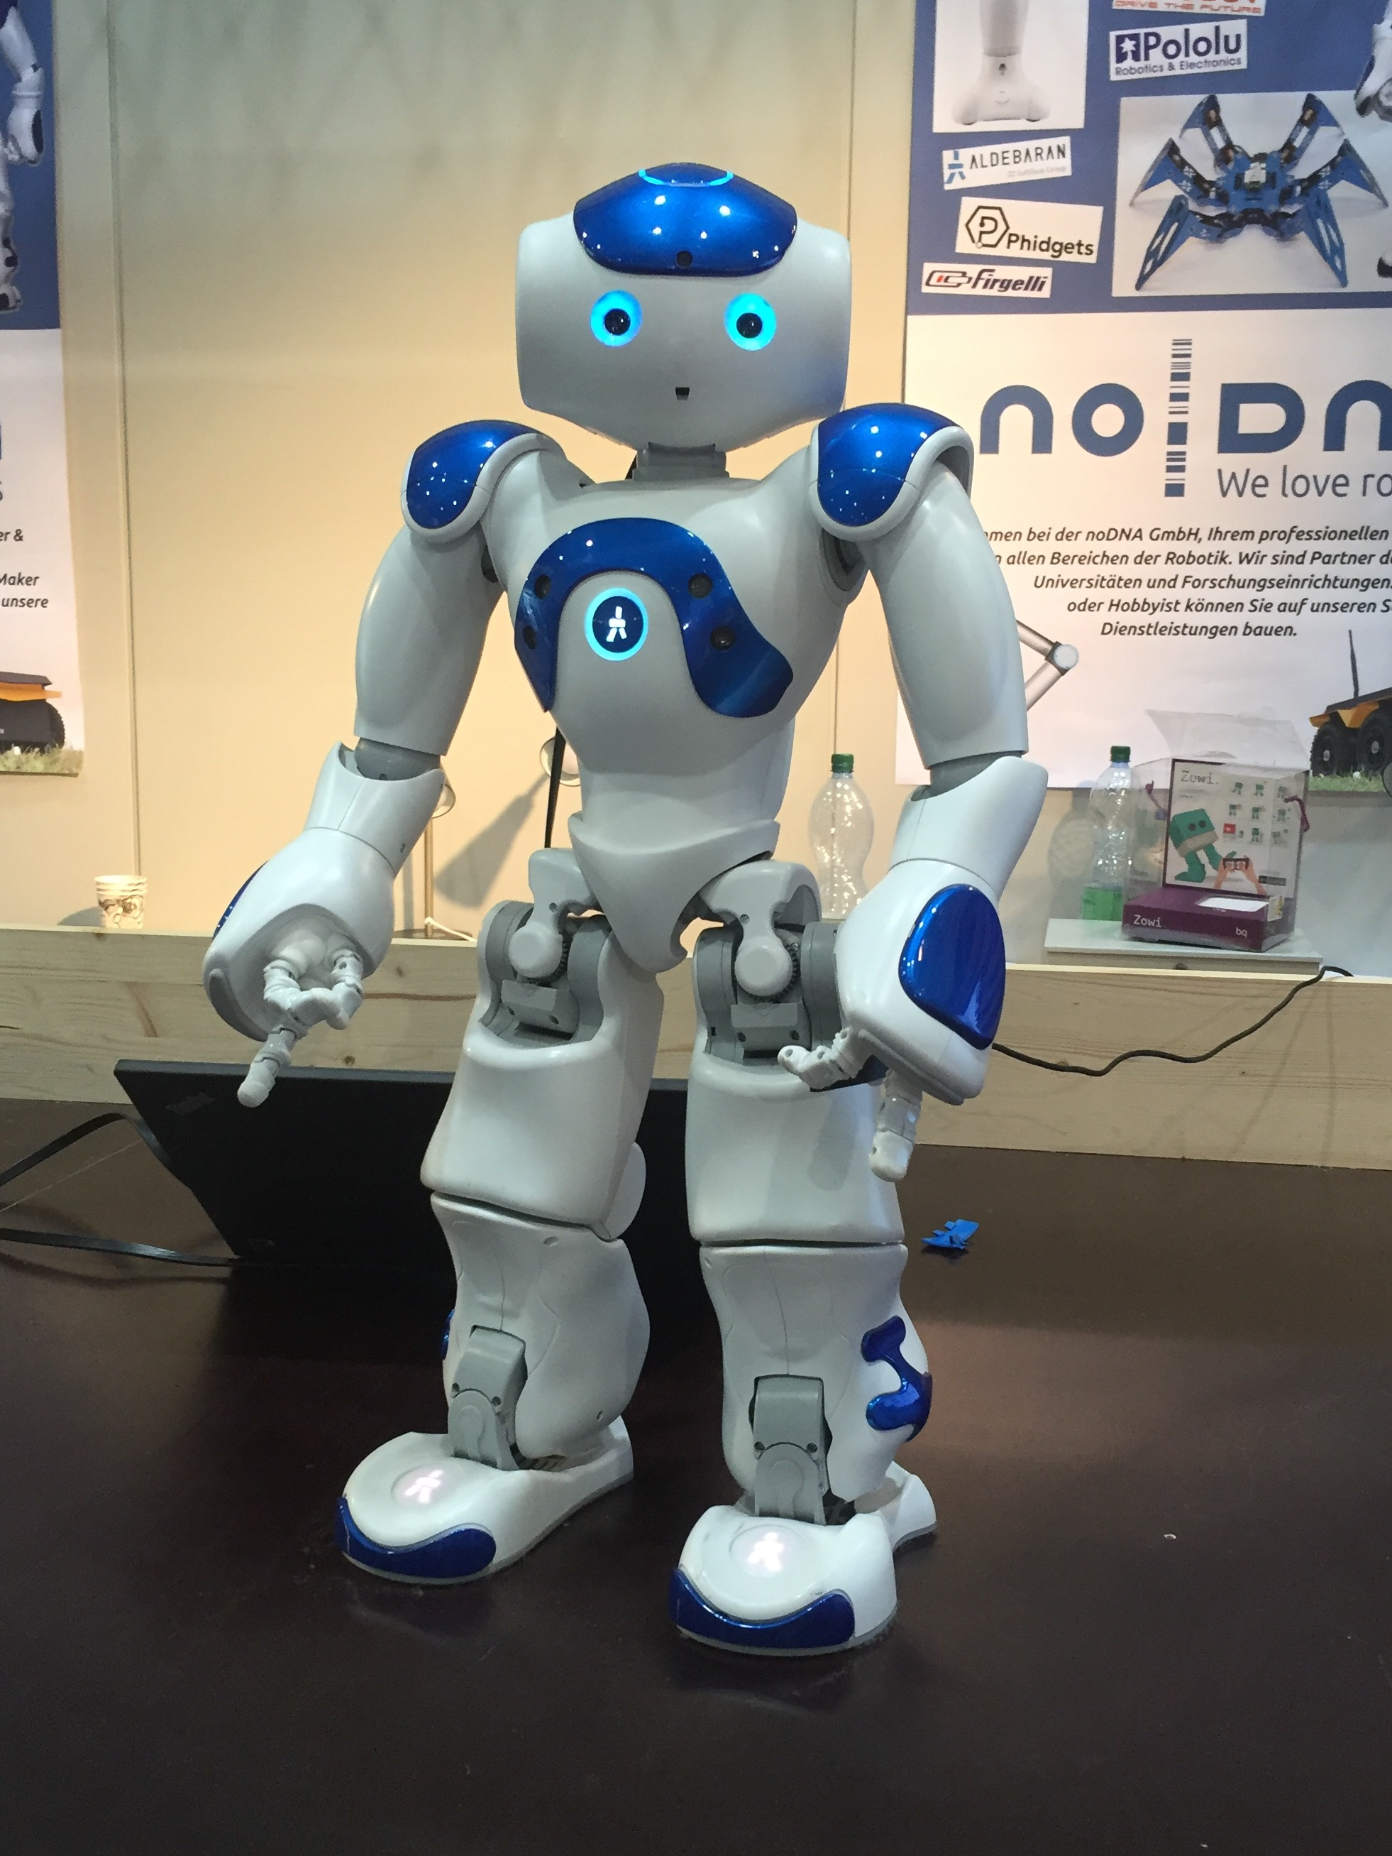
Robot Golfing Competition
Nao is an autonomous, programmable humanoid robot.
The main two challenges of Nao golfing control are the golfing motion control and the situation awareness for information such as golf ball, real-time competition instructions, etc in an adaptive environment.
Thus, I developed a closed-loop feedback control using Force-sensitive Resistor (FSR) for controlling the coordinates of the hitting, and a robot’s computer vision system for recognizing the red golf ball and optical characters.

Slide 3
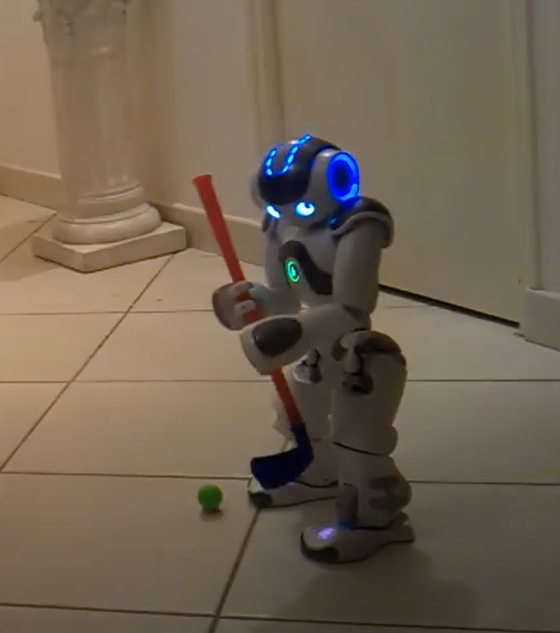
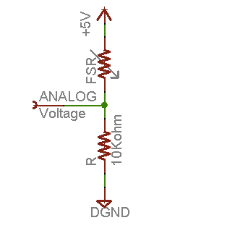
Closed-loop feedback control using Force-sensitive Resistor (FSR)
Principle: find the robotic I/O layout of analog, GND and 5V (as power). Connect FSR from 5V output, in serial to 10K resistor, then ground. Having analog (ADC) trace the voltage.
By developing and implementing the circuit and Nao’s Arduino data logger, I could record FSR voltages at regular intervals, thus having pressure information at self-defined sampling rate, to control and adjust the coordinates of the robotic arm hitting the golf ball.

Slide 4
Correlation between the coordinates and the Force (Voltage/Resistance)
Voltage – pressure
We transfer pressure to a corresponding visible parameter – coordinate. We have x,y,z 3D coordinate in this application. We can break down the coordinates each direction. For simplicity, we take x-direction for demonstration, so we can control x coordinate to control the pressure applied when playing golf.

Slide 5
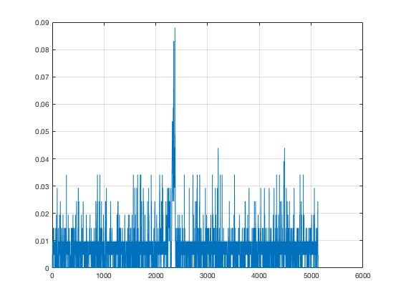
Measurement and Data Logging of the Output Voltage
The analog ADC input to Arduino Uno board of Nao for voltage reading. I used the same Arduino Uno board as in the robotic system, and wrote the Matlab script to plot and analyze the relative ADC counts (y-axis) wrt time (x-axis/ms):
a=arduino('/dev/cu.wchusbserial1420','uno');
interval=10000;
passo=0.05;
x=[];
t=1;
while (t<interval)
b=readVoltage(a,'A0');
x=[x,b];
plot(x);
grid
t=t+passo;
drawnow;
end
By setting passo value, I could manage the interval of the sampling.

Slide 6
Voltage Control over Arduino’s Serial Communication
int fsrPin = 0; // the FSR and 10K pulldown are connected to a0
int fsrReading; // the analog reading from the FSR resistor divider
void setup(void) {
Serial.begin(9600);
}
void loop(void) {
fsrReading = analogRead(fsrPin);
Serial.print("Analog reading = ");
Serial.print(fsrReading); // the raw analog reading
Serial.println(" - No pressure");
/*
if (fsrReading == 0) {
Serial.println(" - No pressure");
} else if (fsrReading < 10) {
Serial.println(" - Light touch");
} else if (fsrReading < 50) {
Serial.println(" - Light squeeze");
} else if (fsrReading < 150) {
Serial.println(" - Medium squeeze");
} else {
Serial.println(" - Big squeeze");
}*/
delay(10);
}
In this way, I could break the pressure into 5 categories, then wrote corresponding functions to control the coordinates in my program.
This works well for applications where the emphasis is on fast response time, rather than on the precision.
For precision, we need to use readVoltage(). The serial communication still holds.

Slide 7
Implementation of the Feedback
Interactively, I feedback voltage reading from FSR wrt time to adjust the X-coordinate, in order to control the pressure along x direction of hitting. Combining forces along 3 directions, I achieved a motion control of golfing.
The feedback information was implemented through the coordinate to Cartesian control API:
Class ALMotionProxy
Void ALMotionProxy::setPositions()

Slide 8
Computer Vision Program Architecture for Red Golf Ball Recognition
Base Class: ConfigureNao(object)
inheriting
VisualBasis(ConfigureNao)
Fcns…
getting a frame from the camera, show frame, save frame, etc.
inheriting
BallDetect(VisualBasis)
Fcn1,
Fcn2,
Fcn3…
RGB Channel Thresholding, image filtering, HoughCircle, etc.

Slide 9
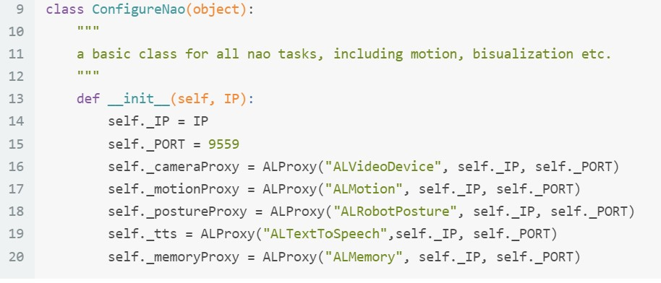
Computer Vision Module for Red Golf Ball Recognition
Base class: ConfigureNao(object)

Slide 10
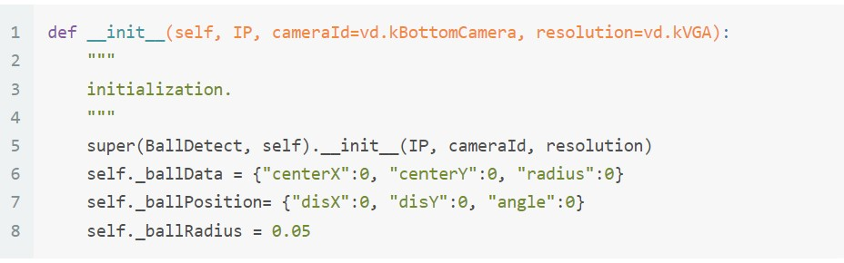
BallDetect(VisualBasis)
Inherit from VisualBasis class, we create BallDetect class (Red ball detection class)
Create _ballData and _ballPosition to store red ball position in the image and actual location

Slide 11
Image Preprocessing
RGB space preprocessing function
Define a function to extract red channel and apply Gaussian blur for better HoughCircle detection
Renormalize dimensions
Subtract G channel and B channel from R channel
3*channelR amplification for red ball recognition
Arguments:
Color: the color channel to split, only supports the color of red, geen and blue
Return: the specified color channel or None (when the color is not supported)
def _getChannelAndBlur(self, color):
Hm = 6
if color == "red":
channelB = channelB*0.1*Hm
channelG = channelG*0.1*Hm
channelR = channelR - channelB - channelG
channelR = 3*channelR
channelR = cv2.GaussianBlur(channelR, (9,9), 1.5)
channelR[channelR<0] = 0
channelR[channelR>255] = 255
return np.uint8(np.round(channelR))

Slide 12
Find Red Golf in the Image
Define _findCircles(self, img, minDist, minRadius, maxRadius):
"""
Arguments:
img: image to be detected.
minDist: minimum distance between the centers of the detected circles.
minRadius: minimum circle radius.
maxRadius: maximum circle radius.
Return: an uint16 numpy array shaped circleNum*3 if circleNum>0, ([[circleX, circleY,radius]])
else return None.
"""
circles = cv2.HoughCircles(np.uint8(img), cv2.HOUGH_GRADIENT, 1, minDist,
param1=150, param2=15, minRadius=minRadius, maxRadius=maxRadius)
#param1: Accumulator higher threshold 150 (higher threshold of the two passed to Canny Edge Detector)
#param2: Accumulator threshold for the circle centers at the detection stage.
The red golf ball in the competition is standard, so we could estimate the red ball radius range in the image, depending on the image resolution. The parameters above were set under 640×480 resolution.

Slide 13
Computer Vision Module for Optical Character Recognition(OCR)
During the competition, Nao robots needed to understand real-time instructions in Chinese. So I developed neural network-based (EAST and LSTM) text detection and recognition system.
Tesseract OCR engine: optical character recognition engine for various operating systems. It is free software, released under the Apache License. Originally developed by Hewlett-Packard as proprietary software in the 1980s, it was released as open source in 2005 and development was sponsored by Google in 2006.

Slide 14
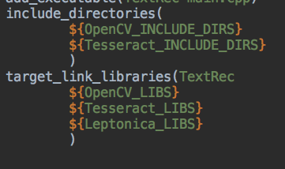
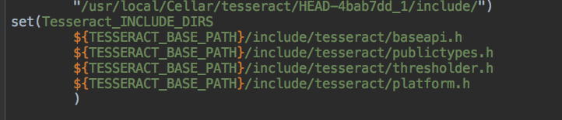
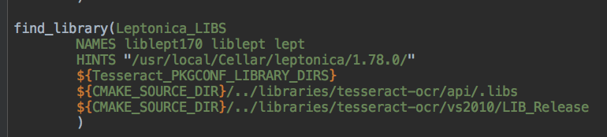
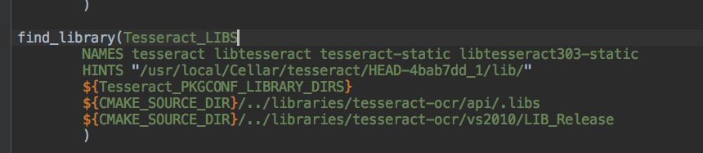
Building Environment
CMake
Header file: include Tesseract directories
Find Tesseract and Leptonica libraries
Leptonica is a pedagogically-oriented open source library containing software that is broadly useful for image processing and image analysis applications.
Include OpenCV and Tesseract two directories
Link Target OpenCV, Tesseract and Leptonica

Slide 15
Tesseract OCR recognition
Installed Tesseract 3 using Homebrew brew install tesseract –HEAD
Adopted LSTM recognition engine
First use OpenCV function selectROI() to choose the region of the image frame containing the characters
Notice Tesseract OCR is language-sensitive, meaning we need to install the corresponding right library for a language
Because labels in the instruction had a fixed format, I created regular expression to match the text in the input frame from the robot’s camera

Slide 16
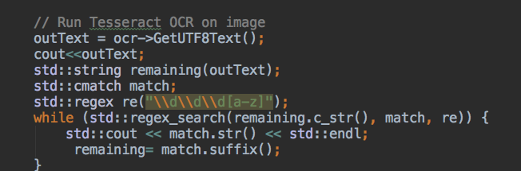
Regular Expression
include<regex.h>
Remaining: let remaining equal outText value
\\d\\d\\d[a-z]
Output cmatch class, match string suffix ->remaining

Slide 17
Summary
For autonomous, programmable humanoid robot such as Nao, in golf competition applications, I developed motion control and computer vision modules:
A closed-loop feedback control using Force-sensitive Resistor (FSR) for controlling the coordinates of the hitting
Nao’s computer vision module for recognizing the red golf ball using base classes and derived classes and image processing methods such as RGB thresholding, image filtering, shape recognition, etc
Nao’s computer vision module for optical character recognition based on EAST and LSTM neutral networks adopting Tesseract OCR engine

Slide 18
Thank you so much!

